Slide 1
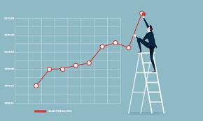
Customer Segmentation
by
Rime Saad

Slide 2
Table of contents:
Problem Statement
Reading the Data in Jupyter Notebook
How the Data Looks Like
Sales by Country
Explore Price Column
Explore Quantity Column
Explore Description, Stockcode and Customer ID Columns
Customer Cohorts

Slide 3
Problem Statement
How would the business achieve deeper insight into customer profiles and behaviour and higher accuracy sales forecasting

Slide 4
What will be covered in this presentation
Data cleaning
Recency, Frequency and Monetary Value and RFM score
Segmenting customers using kmeans and hierarchical clustering
Sales Forecasting

Slide 5
Reading the data:
Create an excel object
data_excel = pd.ExcelFile('../raw_data/online_retail/online_retail_II.xlsx')
Read the excel sheets
Data_excel.sheet_names⇒ Year 2009-2010, Year 2010-2011
Read the data into a dataframe
data = pd.read_excel(‘online_retail_II.xlsx',sheet_name=[0,1])
This is a dictionary with 2 keys
Each key has a dataframe
Each dataframe has 8 columns and about 500,000 rows
df= pd.concat(data.values(),ignore_index=True)

Slide 6
The data
Shape:
1,067,371 rows and 8 columns
5,835 customers and 4,615 products
Columns Names:
InvoiceNumber: number of purchase per customer
Stockcode: number per product
Description: description of product, there are 4,382 nans
Quantity: amount ordered
Price: price of single product ordered
InvoiceDate: date of purchase
Customer ID: 243,007 nans
Country: 43 countries
There was one new feature created:
Sales = quantity*price

Slide 7
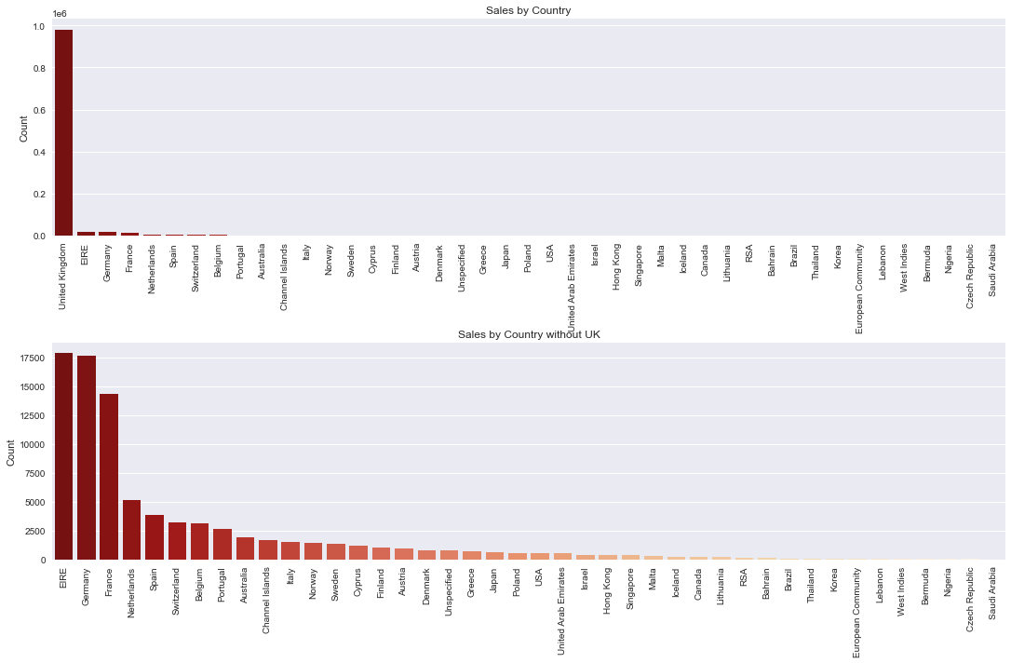
Sales by country
Percent Sales
Sales by country shows that 90% of the sales are for UK customers, but there are customers in 52 other countries
Sales

Slide 8
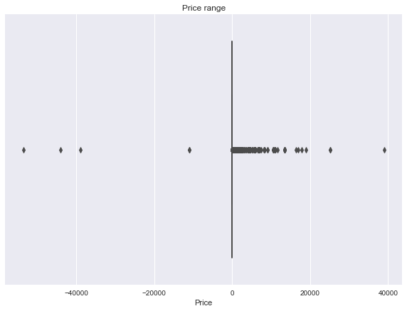
Price
There are some negative and zero prices. Some of the reasons are:
Some of these items had the description of “adjusted bad debt’
And some had descriptions that indicated that the item was damaged, so they were returned items
There were also entries with price equal 0. These entries were deleted they are not considered to be sales

Slide 9
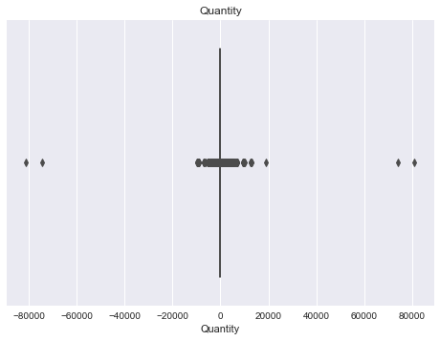
Quantity
There are 19,000 negative quantities that, upon further investigation, turned out to be canceled orders. So there were duplicates in the dataframe where orders were made and then cancelled.
Solution:.
Two dataframes are created, one for positive quantity and one for negative.
A function is implemented that takes in the negative quantity and positive quantity dataframes and the columns to check on, iterate through dataframe rows and match on stockcode, quantity, customer id and country, if there a match then these duplicates are removed from the dataframe.

Slide 10
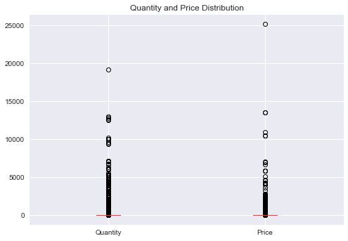
Quantity and Price after cleaning
All positive values and no zeros.

Slide 11
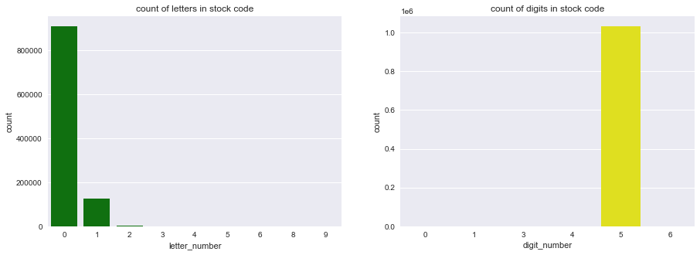
Investigation of the description and stockcode features
There are 4,900 unique stockcodes. To investigate if the code is for an actual product, I looked at the length of the code and made these observations:
Most stock codes are 5 digits long, some with only numbers and some containing letters. Codes of this length are valid product codes.
Some examples of codes that were only letters were “test and gift vouchers” and “Test”. Test is deleted but gift voucher is considered to be a sale so it is retained

Slide 12
Description
Most descriptions are all in uppercase but some are a mixture of upper and lower and the latter can contain strange descriptions like:
gift vouchers
adjusted
Check?
dotcom
manual
Gift vouchers are retained but all the other ones had to be removed

Slide 13
Customer ID
30% of Customers ID is nan
I divided the dataframe into two, one with customers with nan and one with all other customers
There are 5,834 customer
Link to notebook
https://github.com/rime11/customer_segmentation_sales_forecasting/blob/master/Notebooks/data_wrangling.ipynb

Slide 14
Customer Cohorts
Benefits of creating customer cohorts
Give a better understanding on how customer behaviors affect the business.
Once customer behavior is better understood the business can reduce customer churn.
Increase customer lifetime value.
Increase customer engagement.

Slide 15
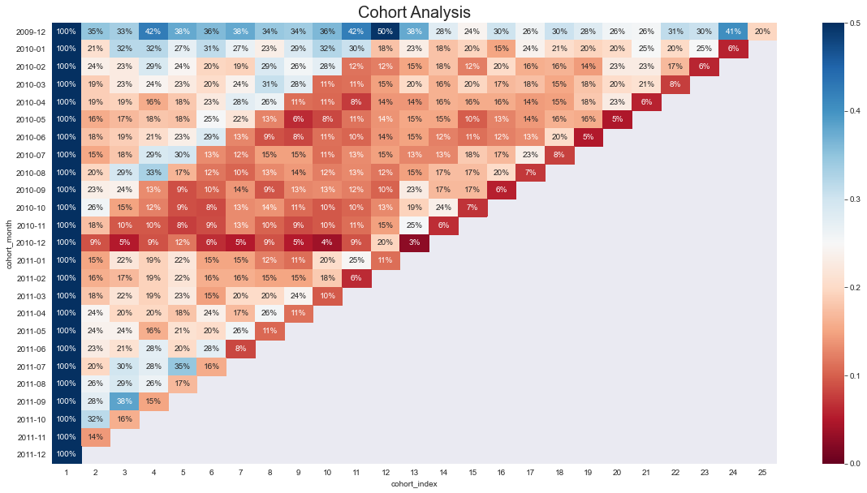
Customer churn using customer cohorts chart
The monthly cohort is calculated by creating a function that calculates the first transaction month per customer. This is the cohort month, and then the consecutive order months are identified for each customer. By adding the number of unique customers that returned on each of the next months a customer churn table is created.
Link to notebook
https://github.com/rime11/customer_segmentation_sales_forecasting/blob/master/Notebooks/customer_cohort_analysis.ipynb

Slide 16
RFM Data Frame
RFM is a marketing technique used to rank and group customers based on the recency, frequency and monetary value of their transactions, the purpose of which is to identify the top customers. This is done to be able to perform targeted marketing campaigns. Businesses are able to give their customers a quantitative value that is measurable and easy to understand.

Slide 17
RFM Definition
The number of days since the last transaction
code:
data_rfm = df.groupby('Customer ID').agg( 'InvoiceDate': lambda x: (snapshot_date - max(x)).days, 'Invoice': 'count',
'Revenue': 'sum'})
The number of transactions in the past period
Code:
recency_q = pd.qcut(data_rfm['Recency'],q=4,labels=labels) ⇒ labels = range(4,0,-1)
How much the customer spent in total in that period
Code
frequency_q = pd.qcut(data_rfm['Frequency'],q=4,labels = labels_f) ⇒ labels_f = range(1,5)
Recency:
Frequency:
Monetary Value:

Slide 18
How the dataframe looks like
Customer ID RFM_segment RFM_score
12346 121 4
12347 444 12
12348 323 8
12349 444 12
12350 211 4
Recency Frequency Monetary Value 529 24 169.36
2 222 4921.53
75 46 1658.40
19 172 3678.69
310 16 294.40
This new dataframe will be used to create customer clusters.

Slide 19
Clustering
Clustering is used to find similar data points and then group them together in the same cluster. This process helps create targeted marketing and improves business strategy.
Kmeans clustering:
An unsupervised learning algorithm used to cluster customers according to their purchase history and past activities and is the most popular clustering algorithm. It is a centroid based algorithm, meaning it creates random centers for data and tries to minimize the distances between the points and their centroid. This process is repeated for different number of centroids until the optimal number of clusters is reached.
How it is done?
First, a range of cluster numbers is chosen, then different metrics are used to measure quality of clusters. The purpose is to minimize inter cluster distances and maximize the distance between the clusters.

Slide 20
What is kmeans clustering?
Finding the right number of clusters is very important to the analysis, too many clusters and each point will start representing a cluster, too few and the clusters do not represent the data. This is also a very subjective problem and requires some domain knowledge.
kmeans requires some data preprocessing.
it requires that all the features have a symmetric distribution, meaning no skewness
variables have the same average value, meaning their means are the same, so they need to be standardized. This ensures that each variable gets equal weight in the kmeans calculation.
variables have the same variance.

Slide 21
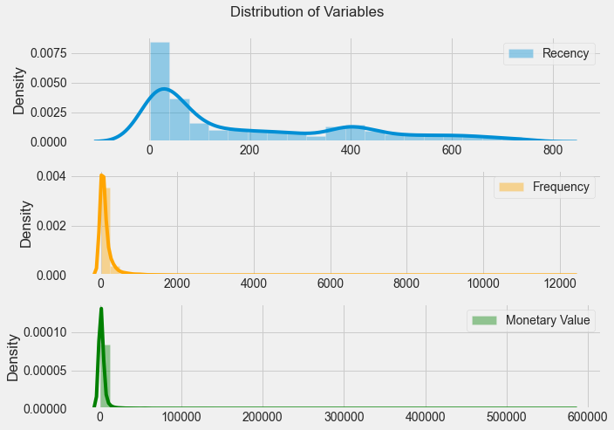
Explore Distribution of Features for Kmeans
All distributions are skewed to the right. Skewness can be measured using skew() method. It needs to be between -0.5 and 0.5 for data to be symmetrical. One way to fix this is to apply logarithmic transformation.
skewness=0.89
Skewness=17.98
Skewness=26.59

Slide 22
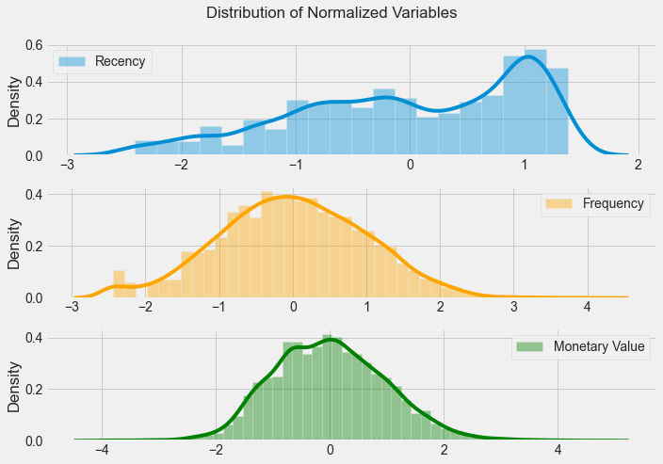
Distributions after Log Transformation and Standardization of Data
skewness= -0.49
skewness= -0.003
skewness=0.26

Slide 23
Kmeans and the Hopkins test.
Before running kmeans, which is an unsupervised algorithm, it needs to be determine if the data set contains clusters or no. One of the tests used is the Hopkins test. The steps are:
generate data that is randomly distributed across the data space
sample actual data
measure distance of nearest neighbor between the generated data and the original data, as well as between the sampled data and original data.
Hopkins statistic is the distance between the generated data divided by the sum of that distance and the distance of the original sampled data. If H = 0.5 then there is no cluster tendency if H = 1 or H = 0 then there is cluster tendency
The hopkin statistic is 0.9 which is close to 1 meaning there is cluster tendency in the data.

Slide 24
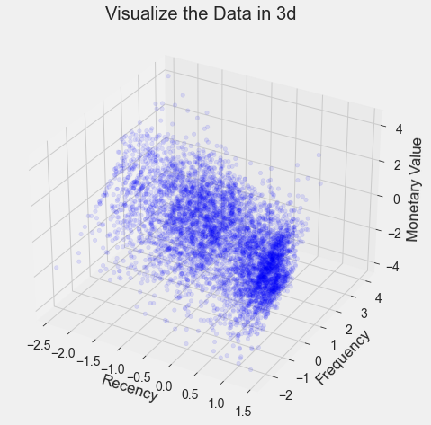
There are some dense areas in the front and middle

Slide 25
There are three metrics to measure how good the clusters are:
The elbow method
Measures within-cluster variance, or the compactness of the cluster. The lower this value, the higher the compactness of clusters formed. This distance is plotted against the number of clusters. This is called the elbow method because what we look for is a slowing down in the decrease of the distance, which looks like an elbow
The Silhouette Index
Measures the distance between each data point, the centroid of the cluster it was assigned to and the closest centroid belonging to another cluster. Values close to 0 indicate overlapping clusters, and values closer to 1 indicate a better separated dense clusters. The formula is b-a/max(a,b): b-a is the distance between the centers
David Bouldin score
Measures intra-cluster similarity and inter-cluster differences. Lower value indicates a better model with a better separation between clusters

Slide 26
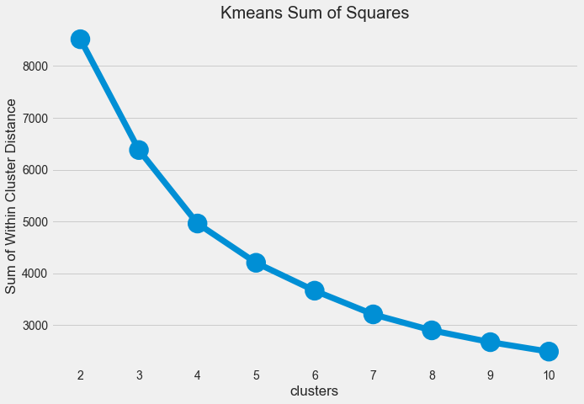
The decrease in distance slows down at 4, but it is not conclusive

Slide 27
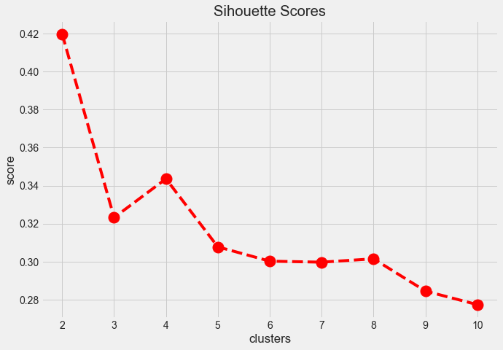
The Silhouette score measures the degree of separation between clusters. So I am looking for the highest value. From the graph I see that the local maxima is at 4.
The score of 0.34 is not very high, which means that the clusters are not well defined

Slide 28
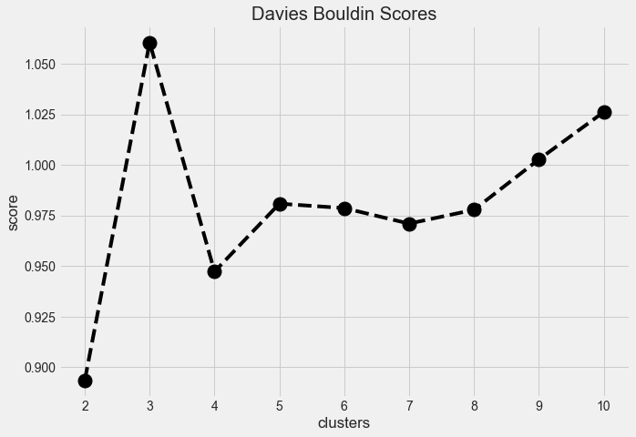
For Davies Bouldin we are looking for the lowest score before an increase, which is at 4 clusters on the graph.

Slide 29
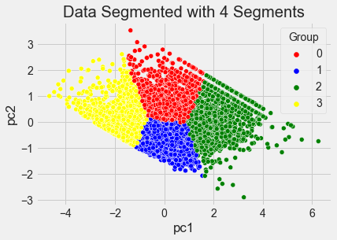
How the data looks like after segmenting into 4 clusters using PCA
The clusters are not well separated, which explains the low Silhouette score

Slide 30
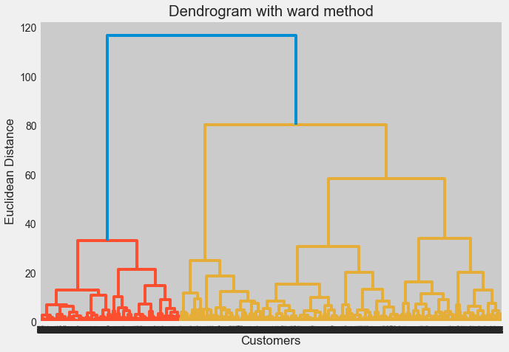
Using Hierarchical Clustering
Cluster 1
Cluster 3
Cluster 2
Cluster 4

Slide 31
Therefore,the data can be clustered in 4 groups but it can be clusters in more groups if the business requires it.
This is how the clusters look like
Recency Frequency MonetaryValue
Group mean mean mean count
0 32 56 731 1251
1 409 20 264 1751
2 19 445 7290 1009
3 216 112 1787 1720
Link to notebook
https://github.com/rime11/customer_segmentation_sales_forecasting/blob/master/Notebooks/customer_segmentation.ipynb
Highest spending and very active customers
Second highest spending but not very active. These customers can become more active with some targeted marketing

